Slide 1
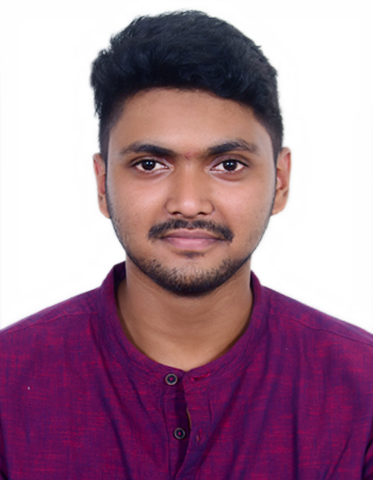

Anshuman Pattnaik
Analyst/Software Engineer
Bachelor of Technology,
Electronics and Electrical Engineering : 2018-2022
I Transform L&D Left shift batch
MUMBAI
Skills
anshuman.pattnaik@capgemini.com
C# | Basics, OOPS, Exception Handling ,Arrays ,Collection and Generics, Delegates and Events, File Io and Serialization.
.NET Framework | ADO.NET,ASP.NET with MVC5 and WEB API, Entity Framework
C++ | Basics , OOPS , Pointers.
Ado.net | Basics Architecture
Database | SQL
Tools | GIT,POSTMAN
UI Technology | HTML5 ,CSS & Angular
Add On Skills | Communication Skills, Team Management, Ability to perceive
+91 9438006582
A4
. A self driven learner with front-end and back-end knowledge.
. A team player with good communication skill always ready to work for the gaining of knowledge.
. Ready to learn new technologies and implement them to further improve my knowledge
Full Stack Developer
Understanding of RDBMS concepts using SQL Server.
Practical understanding of C# and SQL concepts using Visual Studio and SQL Server
Hands on experience in developing applications using .NET Framework, ADO.NET Core
Understanding of HTML5 , CSS and Angular CLI.
Completed case study on Pharmacy Management System which is a Web-based System. To automate drugs purchase from converting the ordering system from manual to online and to meet the requirements and expectations of diverse doctors. This system is built where online ordering of medicines has always been useful for everyone. This system saves and reduces the manual work of the users. Doctors can register to this site or login if already registered and select the medicines and add to cart and purchase the drugs finally from the site.
Technologies used:
ANGULAR
ASP.NET CORE
Microsoft SQL Server
Case Study Video Link
Back-End Github Link
Front-End Github Link
https://github.com/sdsameer07

